Slide 1

APPLIED MACHINE LEARNING — CLASS PROJECT
Predicting the ifo Business Climate
from German News Text
A text-classification pipeline that links German news articles to monthly shifts in Germany's leading business-sentiment indicator.
4,603
2018–2022
ifo Index
articles
coverage
target signal
Mikhail Melnichenko · Yusuf Mustafa

Slide 2



Motivation & Goal
Can the tone of everyday economic news anticipate where business sentiment is headed?
The Question
The Data
The Approach
Does the content of German economic news predict whether the ifo Business Climate Index will rise or fall next month?
5,600+ raw newspaper articles (2018–2022) from monthly archives, paired with the official ifo Business Climate survey.
Frame it as binary text classification: read an article, predict the direction (up/down) of the next ifo release.

Slide 3

Building the News Dataset
From 28 raw archive files to one clean, de-duplicated DataFrame
01
02
03
04
Load & Parse
Extract Fields
De-duplicate
Sort & Label
Read 28 monthly TXT/RTF files; split on “End of Document” to isolate individual articles.
Regex-extract publication date and article body; strip footers and normalize whitespace.
Compare the first 2,000 characters per article to drop near-identical reprints.
Sort chronologically and tag each article with its publication month for merging.
Result: a clean parquet table of 4,603 articles (5,600 raw → 997 duplicates removed), ready to merge with ifo data.

Slide 4

Defining the Prediction Target
Linking each article to the next ifo Business Climate release
4,603
labeled articles
ifo Business Climate Index
Germany's flagship monthly survey of business sentiment (climate, situation, expectations).
38.6%
positive class
(climate rose)
target = 1 if next month's climate score rises vs. this month, else 0.
Each article is matched to the ifo release whose ~1-month window contains its publish date, then labeled with that release's target. Rows without a valid target are dropped.
92–104
ifo index range
observed

Slide 5

Modeling Approach
Article-level text classification with class-balanced models
Feature Extraction: TF-IDF
Pipeline
Raw article text
Top 10,000 features, uni- and bi-grams, min document frequency 5.
80/20 chronological train-test split (no shuffling, to respect time order).
Class imbalance handled with class_weight = “balanced” in each classifier.
TF-IDF vectorizer
Trained classifier
Three Classifiers Compared
Logistic Regression · Linear SVM · Random Forest (500 trees)
Up / Down prediction

Slide 6
Results
Logistic Regression leads after balancing for class imbalance
0.647
best accuracy
(Logistic Regression)
0.761
best F1 score
(Logistic Regression)
Naive majority-class guess ≈ 61% accuracy — the lift from modeling is real but modest.

Slide 7
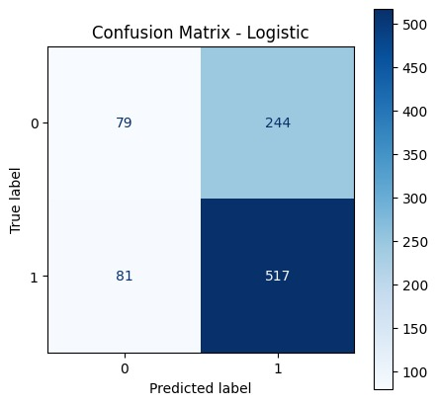
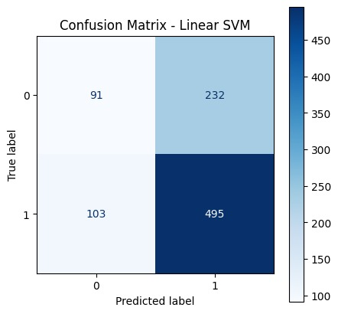
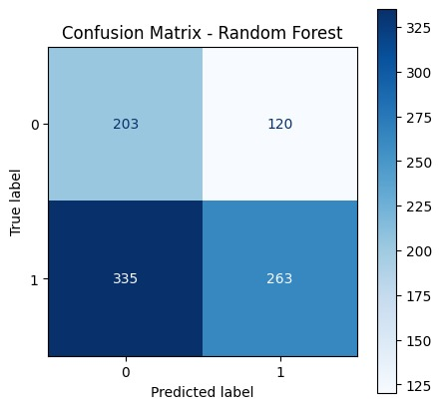
Confusion Matrices
Predicted vs. actual direction across all three classifiers

Slide 8



Takeaways & Next Steps
Pipeline works end-to-end
Raw archives → cleaned, de-duplicated, labeled dataset → trained classifiers, all reproducible in one notebook.
Modest but real signal
Logistic Regression reaches 64.7% accuracy / F1 = 0.761 after class balancing — a few points above the naive majority guess.
Class imbalance was the bottleneck
Adding class_weight = “balanced” shifted the leaderboard — Random Forest's earlier lead was largely a majority-class artifact.
Where this goes next
Address class imbalance further with resampling or threshold tuning.
Aggregate predictions at the monthly level instead of per-article.
Compare against simple economic baselines (e.g., lagged ifo value alone).

